Slide 1
UNIVERSITY INSTITUTE OF COMPUTING
Bachelors of Science in Computer Science
Minor Project
24SCP-258
Calorie Intake Tracker using Excel
An Overview
of Computing
&
Career Planning
Student Name: Pawandeep Kaur
UID: 24BSC10008
Section/Group: 24BSC1-A
Supervisor Name: Mr. Parwan Singh
Employee Code: E15436
Designation: Assistant Profressor
Minor Project Presentation
DISCOVER . LEARN . EMPOWER

Slide 2

Presentation Outline
Introduction to Project
Technology Used
Existing Gaps & Project Features
Objectives
Scope/Relevance
Project Flow Diagram
Comparative Analysis
Conclusion & Future Aspects
Bibliography

Slide 3
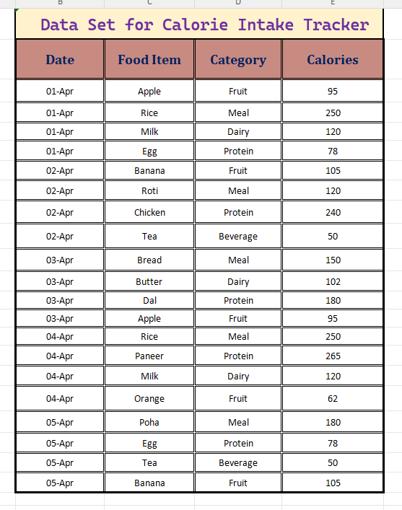
Introduction to Project
This project focuses on tracking daily
calorie intake using Excel
Helps users record food consumption
and monitor diet
Calculates total calories and compares with
a target value
Provides visual insights using charts and
dashboards

Slide 4
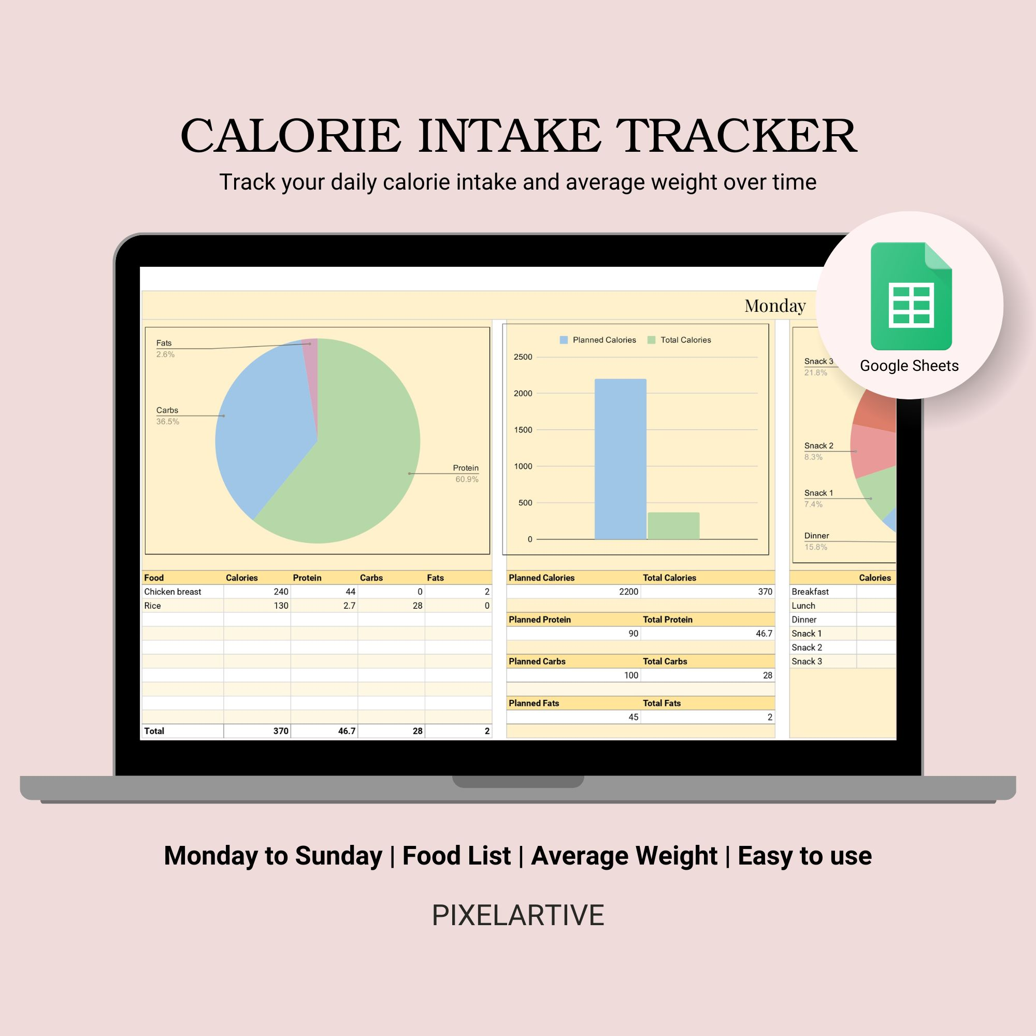
Technology Used
Microsoft Excel
Formulas:
SUMIF (calculate total calories)
IF (comparison with target)
AVERAGE (weekly analysis)
VLOOKUP/XLOOKUP (data lookup)
Tools:
Charts (Line, Bar, Pie)
Conditional Formatting

Slide 5
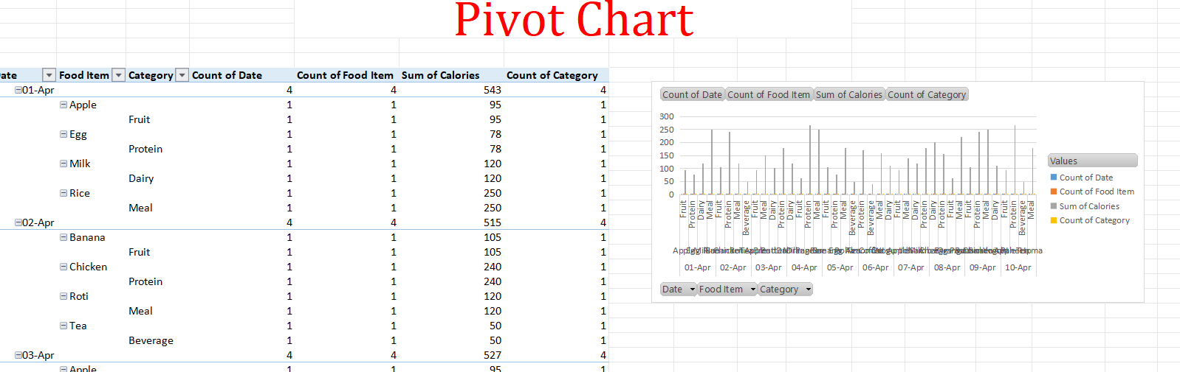
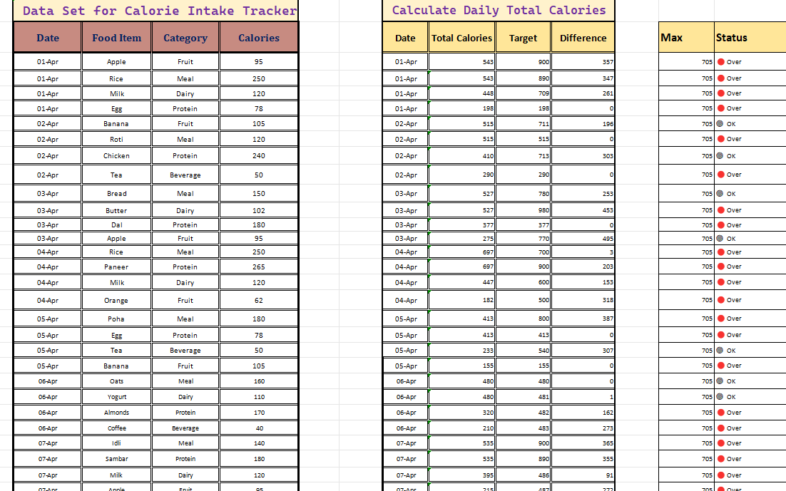
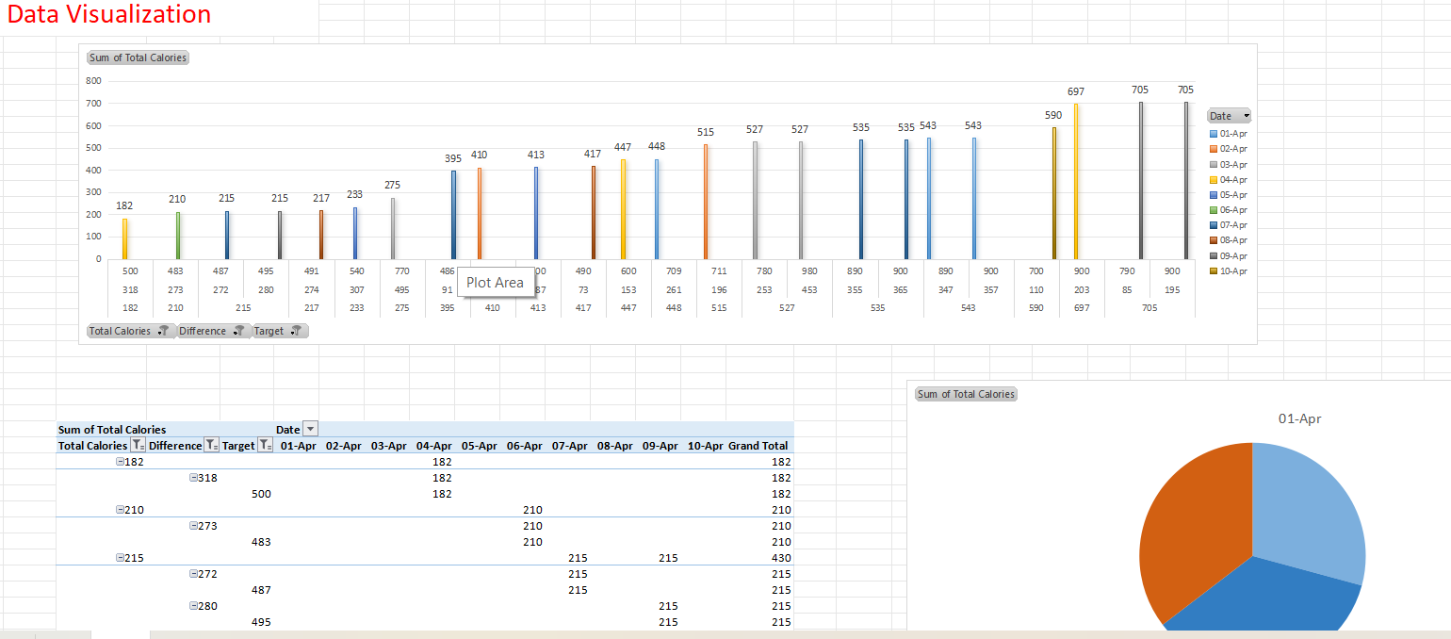

Slide 6
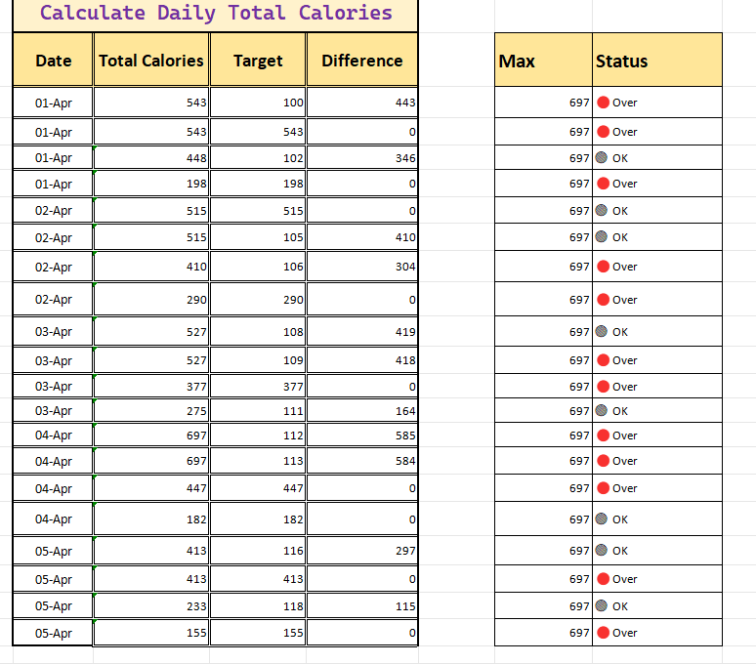
Existing Gaps & Project Features
Existing Gaps
People do not track daily calorie intake
Lack of awareness about eating habits
Manual tracking methods are time-consuming
Project Features
Easy data entry system
Automatic calorie calculation
Target vs actual comparison
Visual dashboards and charts

Slide 7
Objectives
To track daily food consumption
To calculate total calorie intake
To compare intake with target calories
To analyze eating patterns
To create visual dashboards

Slide 8
Scope / Relevance
Useful for maintaining a healthy lifestyle
Helps in understanding eating habits
Applicable for students and fitness enthusiasts
Demonstrates real-life use of Excel in data analysis

Slide 9
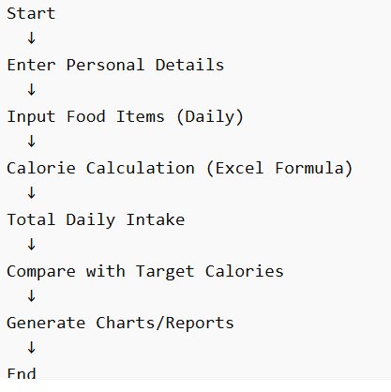
Project Flow
Step 1: Data Entry (Date, Food Item, Category, Calories)
Step 2: Data Processing using formulas
Step 3: Calculation of daily total calories
Step 4: Comparison with target calories
Step 5: Analysis using PivotTables
Step 6: Visualization using charts

Slide 10
Comparative Analysis
Aspect | Before Project | After Project
Tracking | Manual / Not done | Systematic in Excel
Accuracy | Low | Improved
Analysis | Difficult | Easy with charts
Awareness | Low | High

Slide 11
Conclusion & Future Aspects
Conclusion
Excel is effective for tracking and analyzing calorie intake
Helps improve eating habits
Provides clear insights through visualization
Future Aspects
Automate data entry
Add BMI tracking
Use larger datasets
Integrate with mobile apps

Slide 12
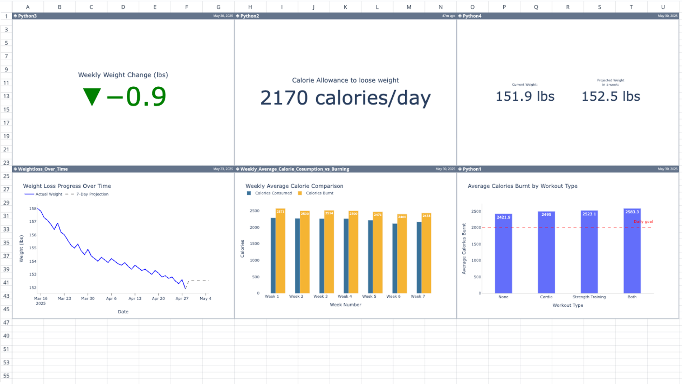
Bibliography
Online calorie charts
Nutrition websites
References from previous data sets
Microsoft Excel documentation
Online websites for data analyses

Slide 13
THANK YOU

